Slide 1
AWS VPC
Abilash S R

Slide 2
WHAT IS VPC?
Amazon Virtual Private Cloud (Amazon VPC) enables you to launch AWS resources into a virtual network that you've defined. This virtual network closely resembles a traditional network that you'd operate in your own data center,

Slide 3
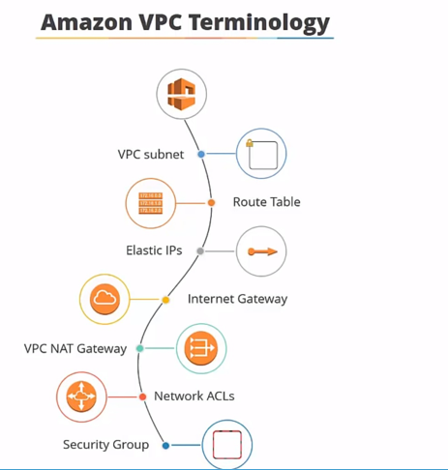

Slide 4
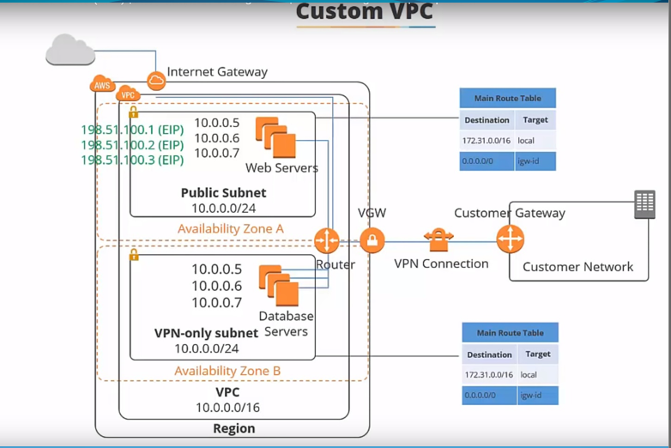

Slide 5
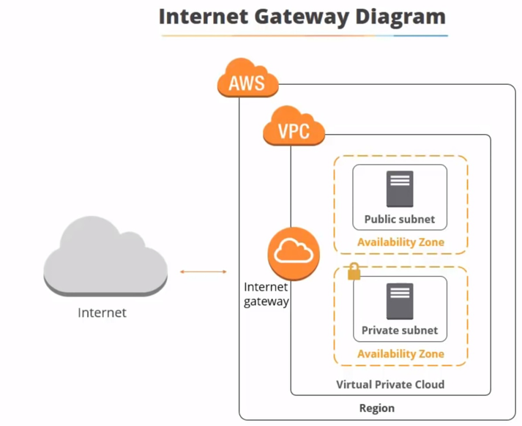

Slide 6
